Slide 1
PASSWORD DEFENDER
A cyber security awareness game
communication and collaboration
Group members
Asutosh Shiwakoti
Bishal shankhar
Roshan poudel
Tej shahi

Slide 2
The problem: why passwords matters
Weak passwords are one of the most common entry points for cyber attacks. Many teenagers reuse simple passwords across accounts, fall for social engineering tricks, or don’t understand what makes a password truly strong. Password defender tackles this gap by turning password literacy into an engaging challenge.
The cyber-safety issue
over 80% of data breaches involve weak or stolen passwords
Teenagers often use names, birthdays, or “password123”
Most young users cant identify a phishing attempt targeting credentials
Passwords reuse across accounts multiples the risk

Slide 3
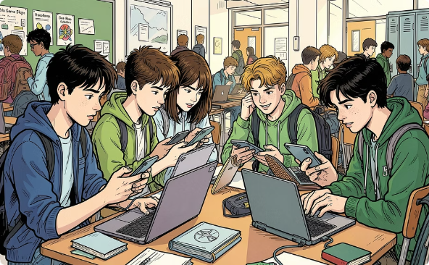
Target audience: teenagers
Understanding your audience is essential to designing an effective game. Teenagers face unique digital risk – they’re active on social media, create multiple online accounts, and are often the first targets of phishing and social engineering. Your game speaks directly to them.
Who they are:
age 13-18, digitally connected, active on gaming platforms,
Social media, and streaming services. They create accounts
Constantly – often without thinking about security.

Slide 4
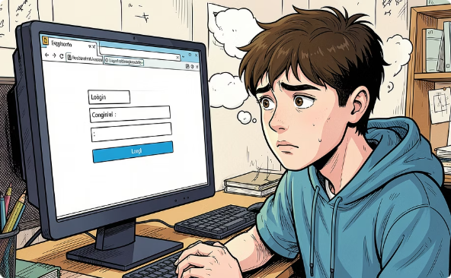
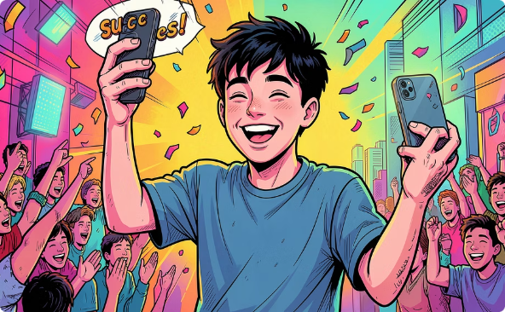
What they don’t know:
most teenagers cant explain the difference between a
Strong and weak password. They underestimate how
Quickly attackers can crack common patterns.
How the game reaches to them:
by using tricky questions and game mechanics instead of lectures, password defender meets teenagers where they are – in a format they already enjoy.

Slide 5
GAME CONCEPT: PASSWORD DEFENDER
The core idea
Password defender is an interactive quiz-style game that challenges players to spot the difference between weak and strong passwords through tricky, scenario-based questions. Players must tink like both a user and a hacker – identifying vulnerable passwords and understanding why they fail.
Learning objective
By the end of the game, players should be able to:
Identify what makes a password weak or string
Recognize common password mistakes
Apply best practices to create secure passwords

Slide 6
Core game loop
Player sees a password scenario or example
Player answers a tricky multiple-choice questions
Game provides instant feedback explaining the answer
Score accumulates – challenge increases each round

Slide 7


UX AND ACCESSIBILITY DESIGN
Great cyber-safety education only works if players can actually use your game. Your UX and accessibility choice show that your team thought carefully about every user- not just the average one.
visual clarity
high-contrast colors, large readable fonts, and clear visual cues help players understand feedback instantly without confusion.
responsive layout
teenagers access content on phones, tablets and laptops. Your prototype should work smoothly across devices and screen sizes.

Slide 8

Accessible design
consider color-blind friendly palettes, keyboards navigation support, and screen-reader compatibility. Accessibility isn’t optional – its part of good design.
fast and intuitive
minimal loading times, simple navigation, and clear instructions on every screen keep players engaged rather then frustreated.

Slide 9
TESTING, FEEDBACK AND TEAM COLLABORATION
Testing and feedback
who we tested with
we tested our prototype with our peers, target users, and instructors who played the prototype.
what we learned
key findings – what confused players, what worked well
what we improved
specific changes made based on feedback received

Slide 10
Team collaboration evidence
Roles
asutosh- responsible for presentation
roshan- managed github, coordinated testing, and ran team meetings to keep us on track
reeshim rai- led game design and wrote all quiz questions, shaping the learning experience
bishal shankhar- built the prototype in unity and handled ux design for a smooth player experience and worte all the code
tej shahi- supported communication, collaboration, and team coordination throughout the project

Slide 11
Meetings
most of our meetings were done in our classroom where we discussed about our design, game concept, quiz questions and how we can make it more interactive and user friendly.
we also conducted online meetings to further work on our prototype.

Slide 12
CONCLUSION
SUMMARY
In summary, password defender was developed to educate users about passwords threats and the importance of creating strong and secure password through interactive gameplay and feedback.
Password defender teaches teenagers to think before they type – because one strong password can be the difference between safe and compromised.

